Slide 1




Breakthrough Local Content
Is being “LOCAL” REALLY A COMPETITIVE ADVANTAGE?

Slide 2

Agenda
The biggest obstacle to creating breakthrough content
How to find local content that breaks through
Breakthrough preparation
Breakthrough presentation

Slide 3

Being local…isn’t enough.
Localism is a personal connection, not a geographic place (you can be boring, generic and irrelevant anywhere!)
Audiences know where, and how, to find compelling, meaningful, relevant content
Being “local” is part of a strategy but it often falls short of winning hearts and minds of today’s audiences
Coaching the talent and coaching the coaches has become rare and is often done poorly

Slide 4
Where did all the interesting people go?
What separates the good ones from the great ones?
Is being “local” enough?
Why does so much of our content look, sound and feel the same?

Slide 5
Where to find personal, compelling local content
Obvious sources: Facebook, X, Instagram, Snapchat, USA Today, prep services, local news, newspapers, social media, etc.
Everyone has access to that content
Breakthrough Talent recognizes compelling content in their own lives and experiences if given the tools, support and encouragement to bring these ideas to their work
Most talent avoid sharing their authentic observations, fears and reactions with their audience. Why?

Slide 6
Breakthrough Content
News, current events and sports is a good place to start…but it’s available everywhere and to everyone.
Your relationships, family and friends
Your co-workers; your job
Your commute
Books, movies, concerts, performing arts
Festivals, fairs, events
Faith, church, services
Sports
Eavesdropping
Shopping, eating, socializing
News and social media outlets

Slide 7





We spend too much time thinking about the audience and not enough time understanding what interests us.

Slide 8

What to choose? Why don’t we trust ourselves?
topics you think the audience will be most interested in
topics you are most interested in
and / or

Slide 9
Why aren’t we more interesting?
Predicting what other people will be interested in is imprecise unless it is a story or topic of overriding importance or relevance
Predicting what you are interested in is easier: does the topic elicit an emotional response in YOU?
The most successful “breakthrough” personalities do both, and favor topics that most interest them; they don’t spend too much time trying to predict what the audience will respond to.
Why does most of our content look and sound the same? Why do we tend to hear the same predictable topics? Why don’t we take more creative content chances?

Slide 10


Slide 11

What are we afraid of?
…rejection
…critique
…family
…the boss
…failure
…exposure
…vulnerability
…stupidity
…embarrassment

Slide 12
Tips for reducing fear
Don’t work for people who don’t understand this
Practice and prepare to develop more confidence
Work with people you trust
Don’t seek out unwelcome or unwise feedback
Don’t be a “pleaser”
Laugh. Have fun.
Surround yourself with fun, creative people
Bring WEXL Coaching to your station for this workshop

Slide 13
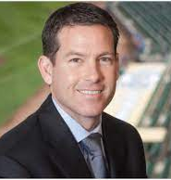
Brian Anderson
“There was a major turn at one point in my career where I stopped being so tuned in outside in, so worried about what people think, what do I sound like as I’m speaking, and you just go inside out.”
“Then it was like, ‘Wait, I can just be me, do me, and if that’s good enough, then that’ll be fine. If not then I’ll go do something else.”
“That was really the big piece for me. When I started doing that, it was like chains fell off me. Shackles fell off me. And I was really able to let it go.”

Slide 14

A real-life example:
Fear and the lost passport

Slide 15

A real-life example:
Paul McCartney’s bagel

Slide 16
THREE ELEMENTS OF THE CREATIVE PROCESS
MADMAN
ARTIST
CRITIC
All three should be part of preparation, presentation and evaluation of content

Slide 17
Stage 1: “MADMAN”
This is where the ideas flow; anything goes, no judging!
Stage 2: “CRITIC”
This is where you start honing in on the topics you find most interesting; it’s okay to start judging
Stage 3: “ARTIST”
This is where you determine how you want to present the idea to your fans

Slide 18
Stage 1: “MADMAN”
Over the past 24 hours, what have you seen, heard, experienced or felt? Don’t worry about what others might think, let the ideas flow – the more the better. Quantity, not quality. Anything goes!
This can be done individually or with your producer or a trusted colleague, but remember, no judging…that comes later.
Don’t shortcut the “madman” stage.
Memorialize your thoughts somehow – lists, iPhone notes, etc.

Slide 19
Stage 2: “CRITIC”
We usually get to the critic too quickly.
You have a ton of ideas – some are big, some are small, some are silly, some are profound.
Examine your list: pay attention to your own response to each item – which ones elicit an emotional response in YOU: anger, humor, joy, sadness, happiness, laughter, dismay, curiosity, disgust, love, hate, etc.
Ask: “What do I truly think/feel/believe about this?”
Avoid letting external influences impact your inner critic
The items that you are most drawn to are most likely the ones that will break through.

Slide 20
Stage 3: “ARTIST”
How do you want to present your topic or idea?
An editorial can be a statement of your thoughts without fan engagement.
A caller segment involves caller/fan interaction (calls, texts, etc.)
A poll can create engagement with fans.
A guest can provide details or an opposing view.
A group discussion can be entertaining and illuminating.
We’re in show business, your presentation as an artist is part of why the audience is here. You are an artist.
Regardless of how you choose to present your ideas, you must manage the process, not the other way around. Be intentional.

Slide 21
Preparation: Organize your ideas
WRITE DOWN which element of the story is MOST INTERESTING to you?
WRITE DOWN what DETAILS of the story are most vivid or relevant to you? Use specific words and descriptions.
WRITE DOWN your personal, authentic idea/view/opinion/take about the story.
WRITE DOWN what you’d like the audience to do specifically with this story – how do you want them to engage?

Slide 22
The three elements of breakthrough content
  PROVOCATIVE POINT, with a trigger lead: what do you want to say about the topic? (“Lost passport” example)
  DAZZLING DETAILS: the specific descriptions of what happened, what you read, what you saw, what you think.
  POWER OUT: you invite the audience to engage with you, in a clear, unambiguous way; re-state your PROVOCATIVE POINT and give instructions.

Slide 23
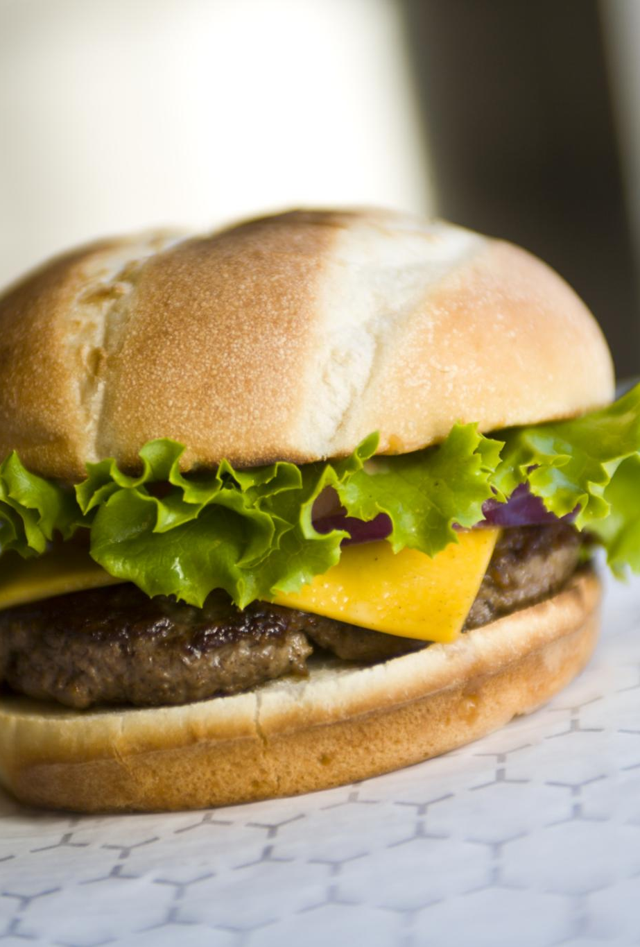
The secret sauce: Dazzling Details
A beautiful woman
The perfect cheeseburger
A great touchdown pass
A bad driver
An ugly dog
A rude relative
The perfect Christmas morning
A lousy movie
A crooked politician
A disastrous blind date
A boring presentation

Slide 24

Power Out
A clear, unambiguous POWER OUT: a set of instructions, as specific as possible, that lets the audience know what you want them to do.
A conclusion, a call to action, a punctuation!
“Lines are open, give us a call, I’d like your reaction” is not a Power Out.
“We’ll have to keep an eye on that to see what happens” is not a Power Out.

Slide 25
Breakthrough guests?
Guests sometimes add dazzling detail or can support a provocative point
Guests can DETRACT from the compelling content we are striving for by prioritizing their agenda, not yours
WHY are you giving a guest access to your precious relationship with your fans?
If the guest is an “obvious newsmaker”, they can play a role (but even then, why is the guest more interesting than you?)
Be especially wary of POLITICIANS and AUTHORS
Turning your show into a guest fest will put distance between you and your fans and limit your appeal and success

Slide 26
Lack of preparation
Chit chat
Small talk
Read articles verbatim
Little/no engagement
Radio: “Caller Circles”
TV: Stories no one remembers

Slide 27
Takeaways
Content is everywhere. Our fans have control of where to find it.
Much of our content has become generic, similar and forgettable.
Fear has infected our content teams, creating a risk averse culture.
We overly rely on research, consultants, corporate templates and “best practices”, resulting in sameness
We think too much about our audience and suppress our own unique, interesting (and often compelling or surprising) life experiences and ideas.
Radio and TV has landed on “local” as a strategy to compete.
Local, by itself, is a location, that lacks a benefit to our fans.
Local content that creates an emotional, personal connection works.
Most of our content creators lack the tools, awareness and support to create more compelling local content.

Slide 28
WEXL Coaching, LLC
wexlcoaching@gmail.com
(414) 254 – 7884
www.WEXL.net
https://www.linkedin.com/in/wexprofile/

